Slide 1
Spy’s gone rogue

Slide 2
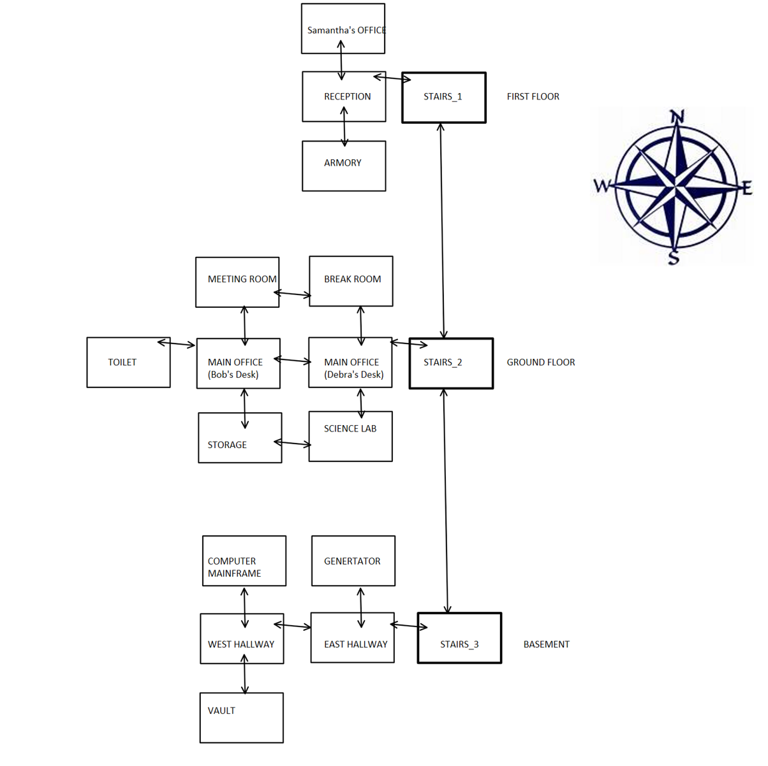
Map

Slide 3
Characters
Bruce (player)
Samantha
Jenifer
Debra
Bob
Stephen
Alexa

Slide 4
Items
Stephen’s USB
Main frame key
Login details
Ink cartridge
Vault logs
Vault key
Vault password
Mugs
Power lead
Heat plate
Documents
Gun
Camera
Recorder
Unknown tech

Slide 5
Design ideas
ASCII art
Music features
Give function
Talk function
Non playable characters
Multiple endings to the game
Combat function
Inspect function
Displaying map in ASCII
Equipping weapons such as gun
Locked doors
Ability to choose a player

Slide 6
Game Demo

Slide 7
Why you should purchase our game?
Multiple endings to the game
Exciting storyline
Lots of characters to interact with
Reactive dialogue to the players actions
Visual aspects to the game (ASCII Art)

